Slide 1
TEXT TO IMAGE GENERATOR
Submitted by:
ANAGHA ANOOP(CEC21CS021)
ARUSHA N S(CEC21CS032)
JENI M ROSE(CEC21CS052)
REVATHY D R(CEC21CS081)

Slide 2
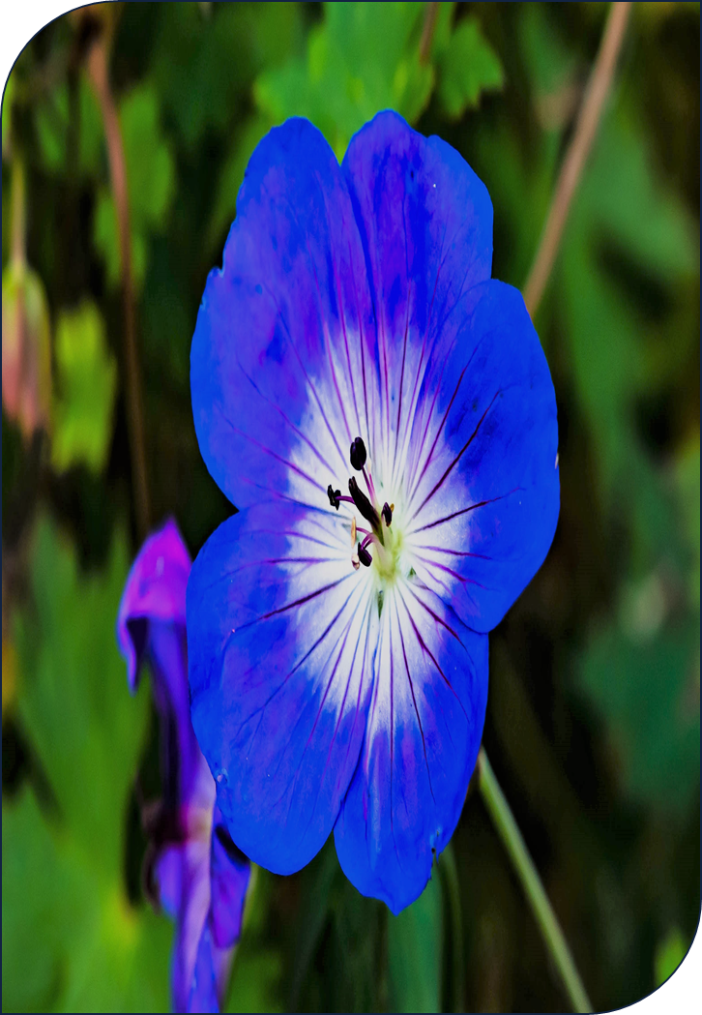
INTRODUCTION
For a human mind, it is very easy to think of new content.
But machines process information very differently.
GANs are a kind of architecture in Deep Learning that can produce content from random noise.
Our aim is to generate images based on the flower dataset.

Slide 3
ABSTRACT
Synthetic content generation using machines is a very trending topic in the field of Deep Learning.
In the recent past Generative Adversarial Networks (GAN) have shown great promise when it comes to generating images but they are difficult to train and condition.
GAN have tremendous applications in generating content in an unsupervised learning approach.
In this project we look at generating 64*64 Images on the fly using a text as an input.
In our system, you can input a text and a synthetic Image Will be generated based on the description of the text.

Slide 4

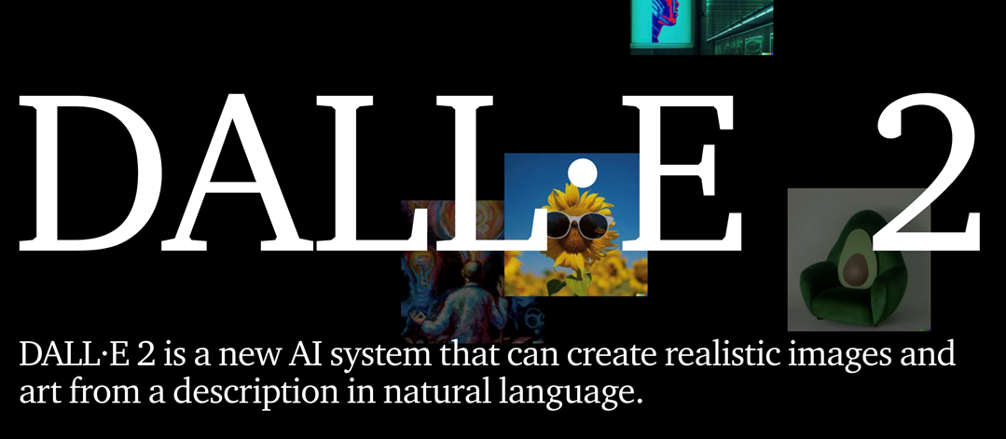
EXISTING SYSTEM
As of our latest update there are many existing systems of similar kind. Some of the prominent ones are given below:
These existing systems can serve as valuable references and inspirations for our project.

Slide 5
PROPOSED SYSTEM
Automated Generation
We propose a system powered by GANs which automates the generation of images, revolutionizing the content creation process through algorithms that learn and ideate autonomously.
Enhanced Creativity
The algorithmic approach opens avenues for enhanced creativity, as the AI can explore design possibilities beyond human imagination, guided by data trends and patterns.

Slide 6
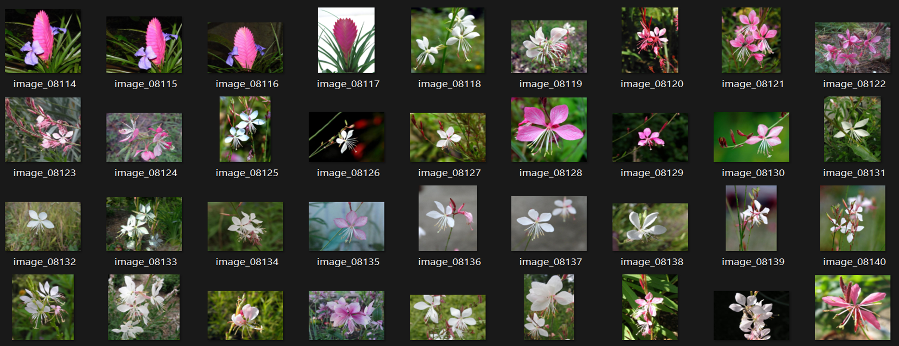
DATASET
Oxford 102 Flower is an image classification dataset consisting of 102 flower categories. The flowers chosen to be flower commonly occurring in the United Kingdom. Each class consists of between 40 and 258 images.

Slide 7
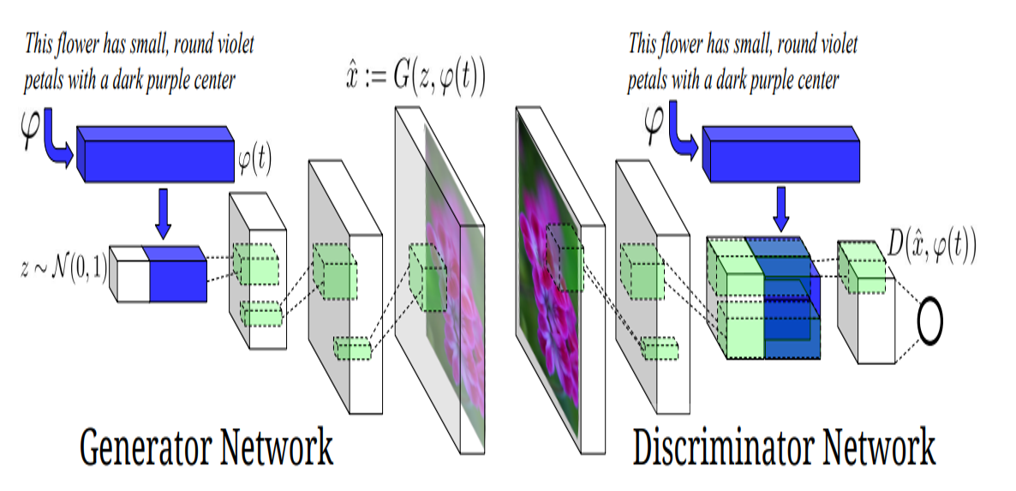
ARCHITECTURE

Slide 8
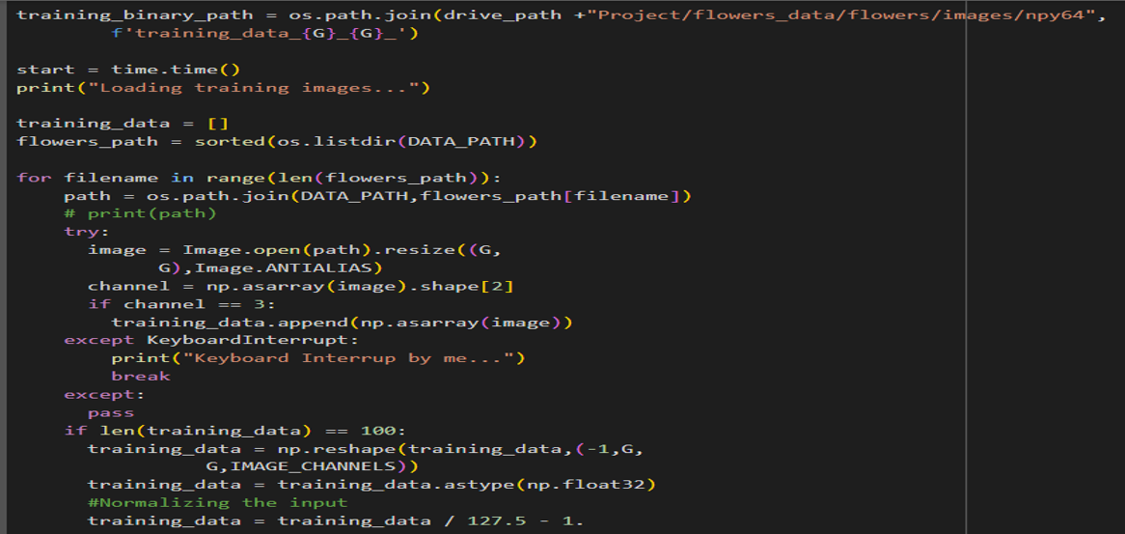
IMAGE PRE-PROCESSING

Slide 9
DATA MODELING
The goal is to capture the essential features and statistical properties of the data in order to generate realistic synthetic samples.
Understanding the Data Domain
Choosing a Network Architecture
Defining the Generator and Discriminator
Training the GAN
Evaluating Generated Samples

Slide 10
DATA MODELING- GENERATOR
Input layers
Input seed: Takes random noise as input
Input embed: Takes additional embedding information
4-convolution layers with 256 filters and kernel size of 5x5 followed by,
Batch normalization
LeakyReLU activation with a slope of 0.2.
Output Convolutional Layer
Produce the output image
Activation function (Tanh) to ensure output values are in the range [-1, 1]

Slide 11
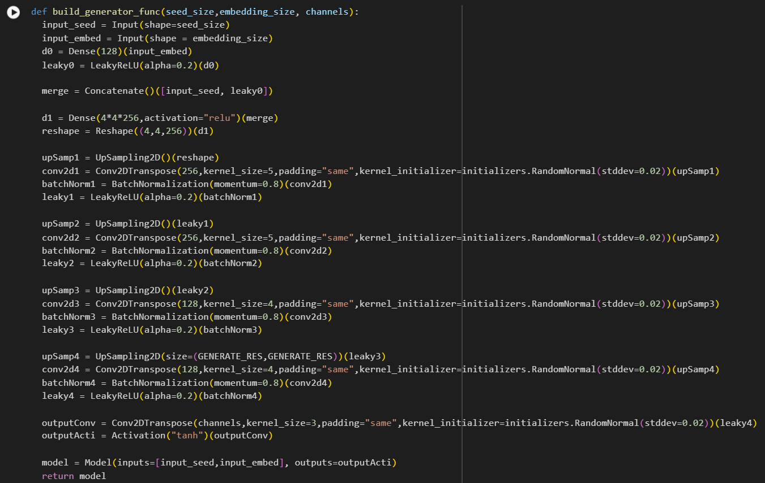
DATA MODELING- GENERATOR

Slide 12
DATA MODELING-DISCRIMINATOR
This discriminator network is designed to take input images and classify them as real or fake.
It learns to discriminate between real and fake images generated by the generator network.
There are
Input layers
4-Convolutional layers each followed by batch normalization , Leaky ReLU, dropout
Flatten layer to convert the 2D feature maps into a 1D vector.
Output Layer:Dense layer with a single unit and sigmoid activation to produce the final output

Slide 13
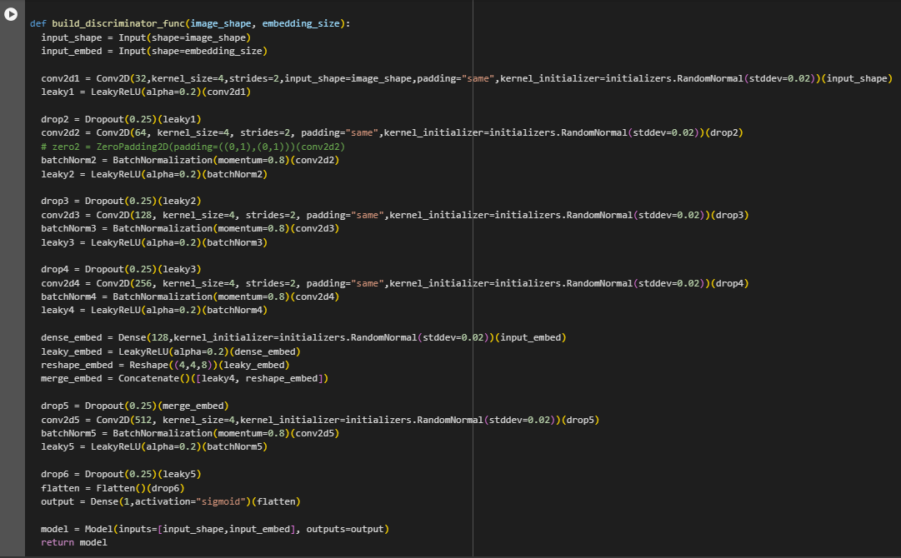
DATA MODELING-DISCRIMINATOR

Slide 14
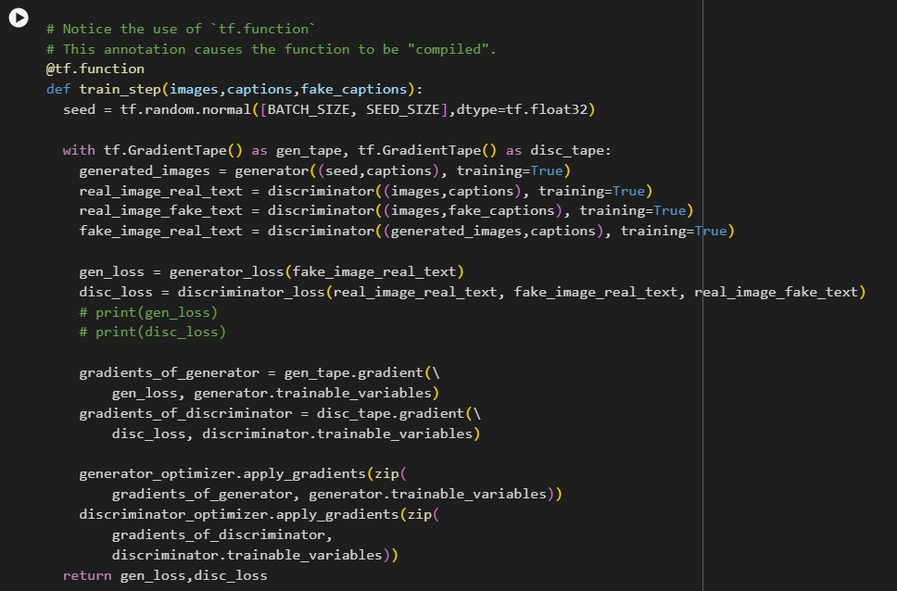
TRAINING

Slide 15
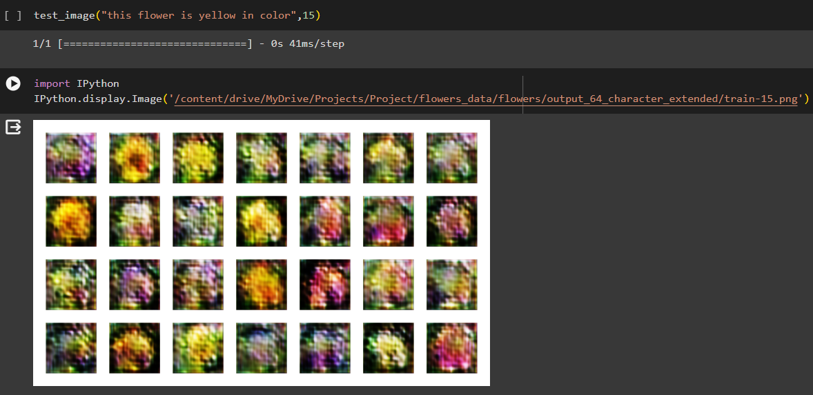
RESULTS
TEXT : This flower is yellow in color

Slide 16
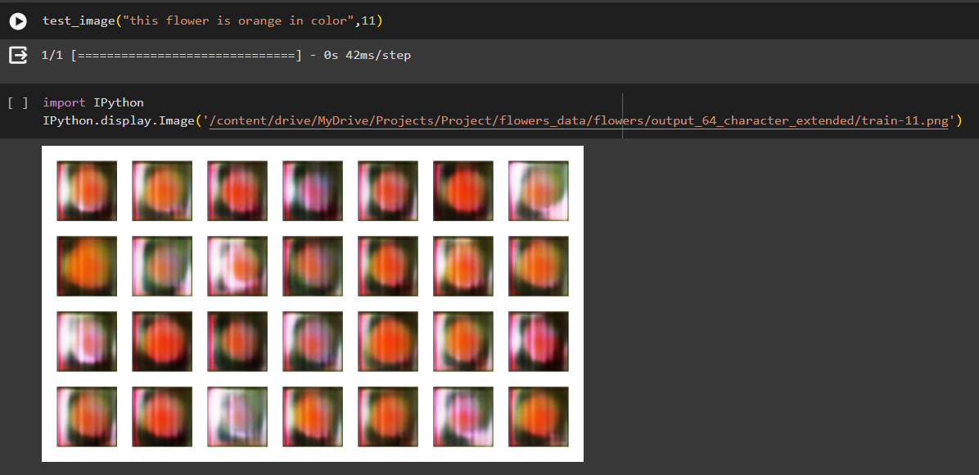
RESULTS
TEXT : This flower is orange in color

Slide 17
TOOLS REQUIRED
Computational Resources:
> High-powered GPUs
> Robust computational infrastructures
Data
Software Frameworks

Slide 18
CONCLUSION
Advancements
The advancements in GAN-based text-to-image generation hold promise for various creative applications.
Potential
This technology has the potential to transform digital art, content creation, and visual storytelling.
Future Scope
The intersection of AI and art has vast possibilities, shaping the future of visual media creation.

Slide 19
REFERENCES
[1] Reed, S., et al. (2016). Generative Adversarial Text-to-Image Synthesis. arXiv:1605.05396.
[2] Mirza, M., & Osindero, S. (2014). Conditional Generative Adversarial Nets. arXiv:1411.1784.
[3] Vinyals, O., et al. (2015). Show and Tell: A Neural Image Caption Generator. CVPR.
[4] Karras, T., et al. (2018). Progressive Growing of GANs for Improved Quality, Stability, and Variation. ICLR.
[5] Kiros, R., et al. (2014). Unifying Visual-Semantic Embeddings with Multimodal Neural Language Models. arXiv:1411.2539.
[6] Zhu, J. Y., et al. (2019). Towards High-Resolution Image Synthesis with Progressive Growing of GANs. ICLR.

Slide 20
THANK YOU!
_____________________________

